Slide 1


Get Resolve Microsoft Stop Working Error

Slide 2
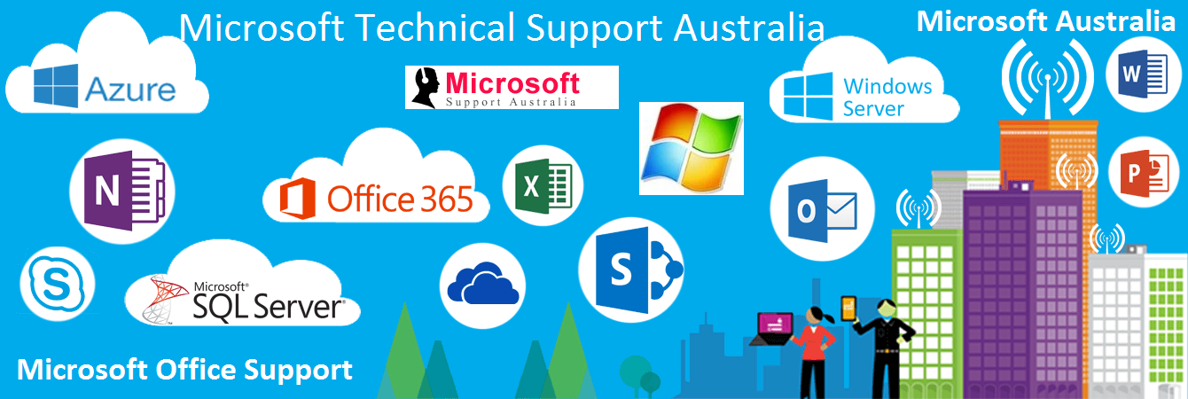
Microsoft program is known for its best performance and applications that render to the millions. There are enormous advantages of using the Microsoft program on your particular device. There is no such restriction for students, professionals, and businessmen. It provides all the features that one needs for their work. Though it is a subscription-based product, you may require purchasing the program for further effort. Microsoft offers products for Home, Student, and Business. According to their requirements people can choose the subscription.

Slide 3
Sometimes it has been seen that people confronting problems with their Microsoft product. If you also facing any issue on your account or it abruptly stop working, does follow the steps mentioned in this document. Moreover, you can call our technicians on our helpline number and avail our services. There are many reasons why your account has stopped working. Some issues are incompatible operating systems; application is outdated, driver or add-in issues, etc. These are the issues that make your account abundant.
To fix the Microsoft error, follow the steps-
Step 1: Automatically repair
  There is function in Microsoft where the system runs a feature to automatically rectify the program.
  On your window 7 and above version, navigate to the Control panel, hit the Programs and Features and select Microsoft Office.
  Then select Repair and then click on the Continue button.
  Now, choose Online Repair and Quick Repair. Wait until the repair process finished and then restart your device.

Slide 4
Step 2: Delete Normal.dot file-
  Navigate to My Computer or This PC.
  Tap on the search box at the top of the window and enter Normal.dot and hit the enter key.
  Now choose the appropriate file from the search results.
  If you have any important file open and suddenly your Word has stopped, you can retrieve your work by pursuing the steps mentioned below.
  Download and install the Ease US Data Recovery Wizard to make install the applications easily.
  Choose the word file location in the drive.
  Right-click on the selected drive and tap on the Scan option.
  Scan all your data; the software will start immediately scanning all lost data on the selected drive, and you’ll see more and more data showing up in the scan results.
  Choose the word files and recover. Once the file is scanned, use a quick way to choose document from the drop-down list. At last tap on the desired document and tap on the Recover button.

Slide 5
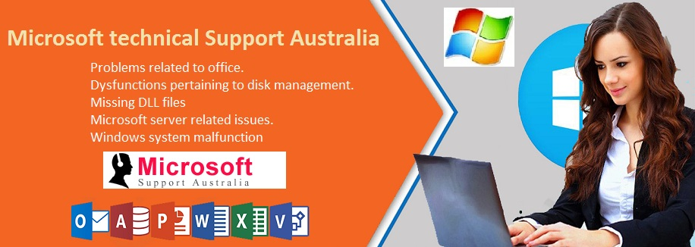
For more help and support, we have the best technical assistance that is at your service to ensure all-day assistance. You can dial our techie’s number and avail their services on Microsoft office support 1800-958-211 . The team will guide you throughout the process and make you resolve your problem effortlessly.
Source Blog: https://microsoft-australia.blogspot.com/2019/10/get-resolve-microsoft-stop-working-error.html

