Slide 1

Dubai Marina Luxury Yacht Tour | Yacht Cruise Dubai
yacht trip dubai
yacht rental dubai marina
yacht rental marina
Luxury Yacht Cruise dubai
yacht charter dubai
luxury yacht dubai marina
cheap yacht rental dubai
Boat rental Dubai
dubai marina yachts
dubai yacht tour

Slide 2
About us:-
Luxury yacht Rental provider in Dubai with best Priced packages and have an exclusive experience and great quality of cuisine, BBQ Platters, 5-star buffet and pick and Drop services. Call us +971-432-18666. A marine cruise that gives memories for a lifetime through the heart of Dubai. Royal blue coast yachts Dubai is the only yacht charter company to own its own fleet which sets the industry benchmarks & standards and made us the pioneers in yacht chartering. Our experience and hospitality knowledge always helped us to cater to the needs of a client’s individual party. We the royal blue coast yachts Dubai takes hold of pride in establishing and introducing ourselves as an amalgamated organization, where the comprehensive sequence of yacht rental services is provided to the travelers. We have an entire dedicated staff and knowledgeable team of extremely motivated staff. The company deed to convey high-quality personalized tours and travel services. We have been serving the people with our great experiencing services for the last 12 years and we continue to serve the same way for the forthcoming years.Royal blue coast yachts Dubai office is located in Dubai Marina. We have so many best price trip packages for travelers to explore the incredible part of Dubai Marina, especially all-around Dubai. Packages like Dubai marina yacht trip provide travel around the famous appealing destinations of the Dubai Sea and enjoy spending your time in the lap of natural beauty surrounding you. ‘’Dubai marina’’ is one of the famous and most preferred yachts cruising routes, where the travelers get to take pleasure in a wide variety of our tour packages, especially nature tour packages.
#yachtcruisedubai #exclusiveyachtdubai #luxuryyachtrentaldubai #dubaiyachts #Luxuryyachtdubai #privateyachtdubai #Boattripdubai #yachtrentaldubai #yachttripdubai #yachtrentaldubaimarina #yachtrentalmarina #LuxuryYachtCruisedubai #yachtcharterdubai #luxuryyachtdubaimarina #cheapyachtrentaldubai #BoatrentalDubai #dubaimarinayachts #dubaiyachttour

Slide 3
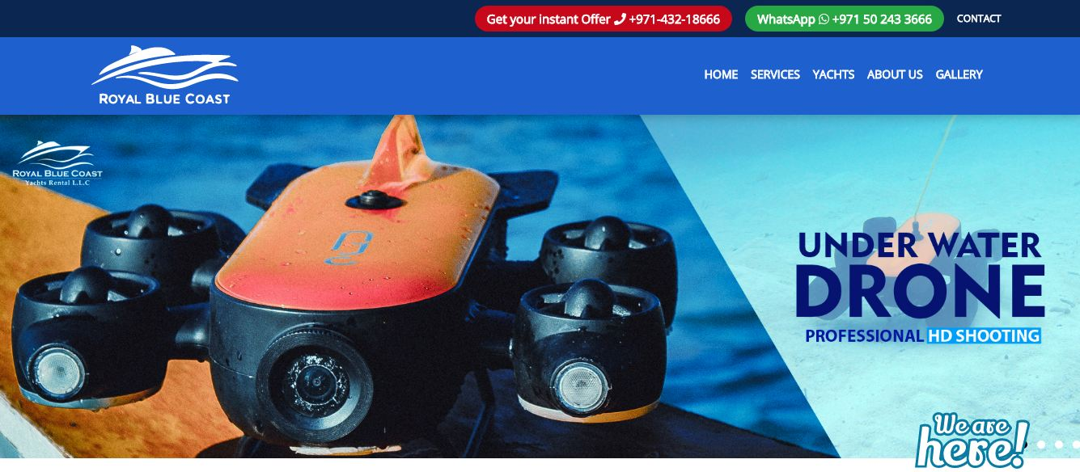
yacht trip dubai

Slide 4

Contact Us:-
Visit Us:-
https://rbcyachtrental.com/

