Slide 1
Top benefits of replacing windows

Slide 2
Your home is the most valuable asset you own, and you try to take the best care of it by keeping all the things up to date. There are various types of repairs that you can make into your house to enhance its look and design.
Out of all the repairs and modifications, windows replacement is considered as the most important and useful change in the house. Windows replacement can be immensely beneficial in increasing your comfort and environment of your home.
You can select a window according to the temperature and the weather conditions of your area. There are various window replacement benefits, along with being highly cost-effective.
Some of the most fantastic window replacement benefits

Slide 3
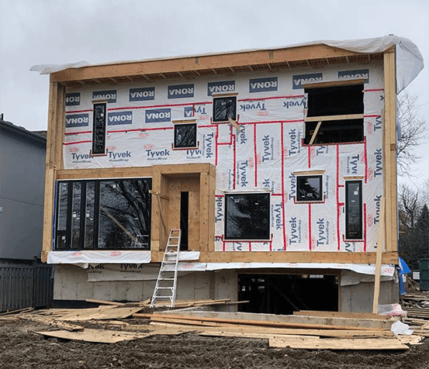

Slide 4
Save energy and expenses
Window replacement is an excellent modification for your house and can save a lot of energy and money for you.
There are various types of windows and well-insulated that are highly beneficial in keeping your indoor temperatures balanced, which puts less load on the cooling and heating system in the house, saving a lot of cost.
There are few window glass tailor-made to save energy in certain climates and have some unique properties that offer protection against the harmful UV rays.

Slide 5
Protection from UV rays
Every person loves sufficient natural lighting in their houses, but with lighting, harmful UV rays also enter the house, which affects the interior and fades it out.
You can protect your interior from UV rays by replacing the windows with UV protected glass, which acts as a sunscreen for your house and protects it from ultraviolet rays.
Check best services here: The Window Experts

Slide 6


Slide 7
Low maintenance cost
Replacing the windows with modern and high-quality windows helps you to lower the maintenance cost of the windows.
Modern windows have unique features that make it long-lasting and easy to maintain. Features like grilles and shades make them easy to clean and dustproof.

